Slide 1
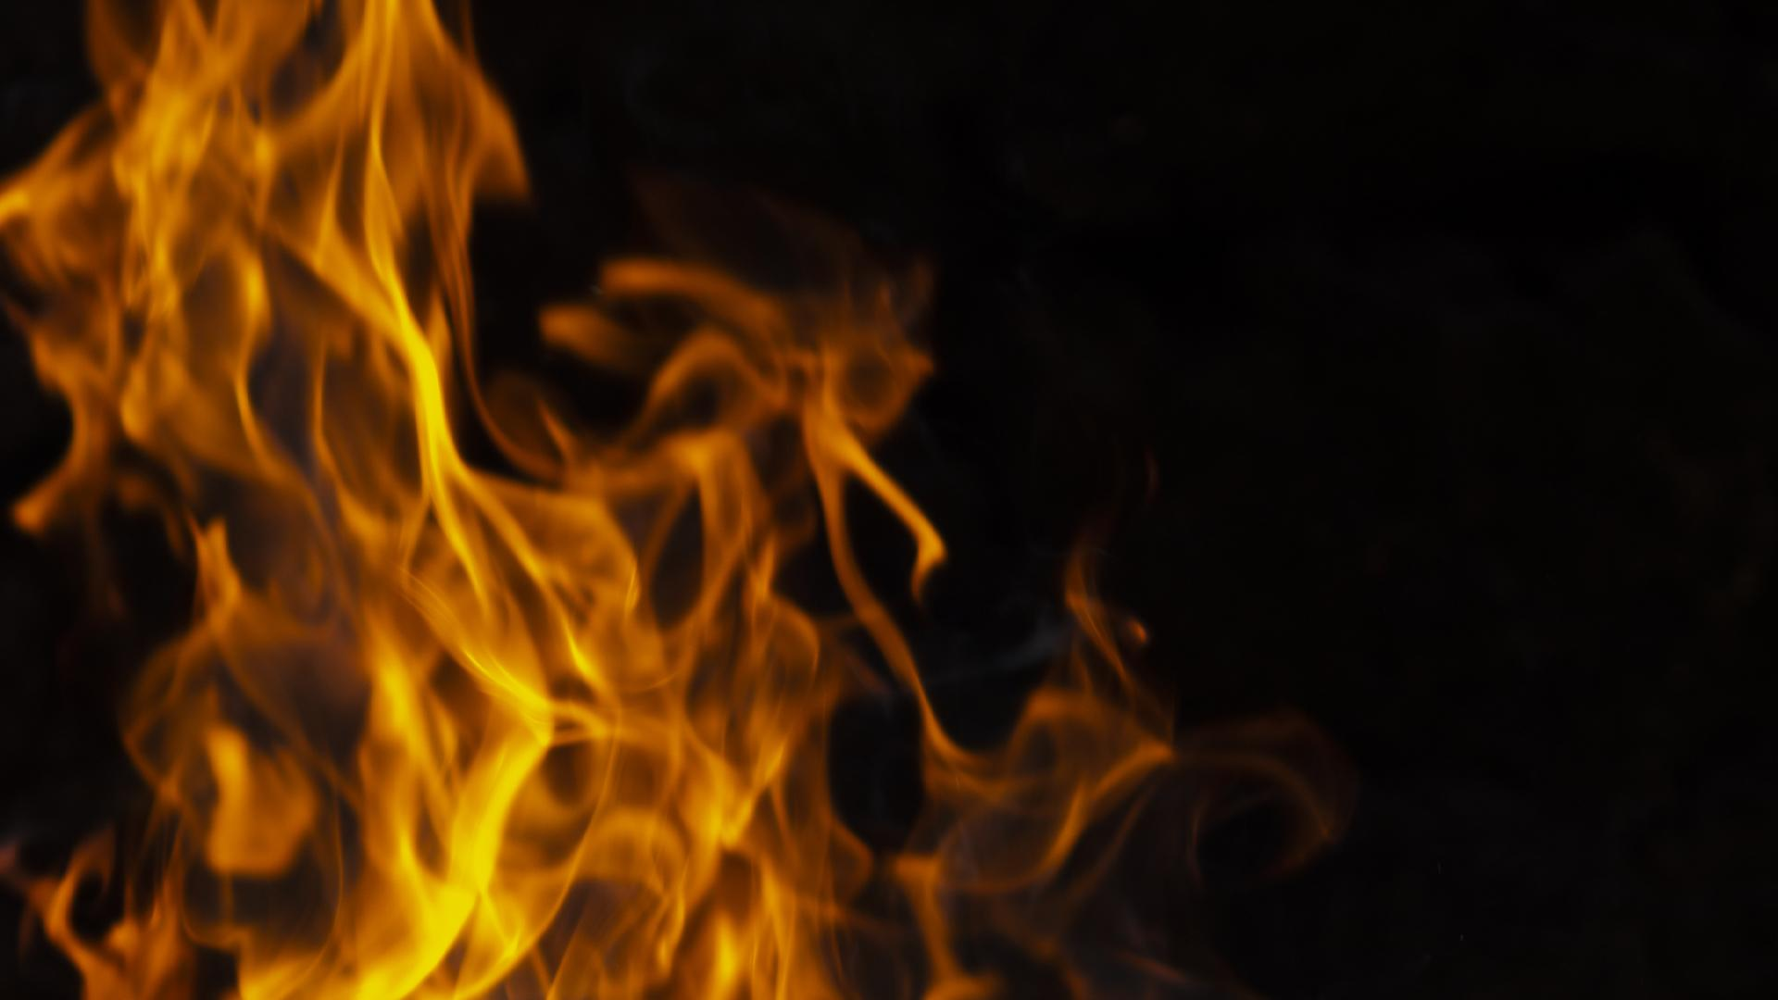
AnalyziNG and predicting WILDFIRES
Group 2:
Celina E., Kent R., Pankaj S., Sujatha

Slide 2
INTRODUCTION
Kent
Insert Content here:
Point 1

Slide 3
Data source
Kent
Insert Content here:
Point 1

Slide 4
Data source - Visualizations
Celina
Insert Content here:
Point 1

Slide 5
Data source – SQL LITE
Sujatha
Insert Content here:
Point 1

Slide 6
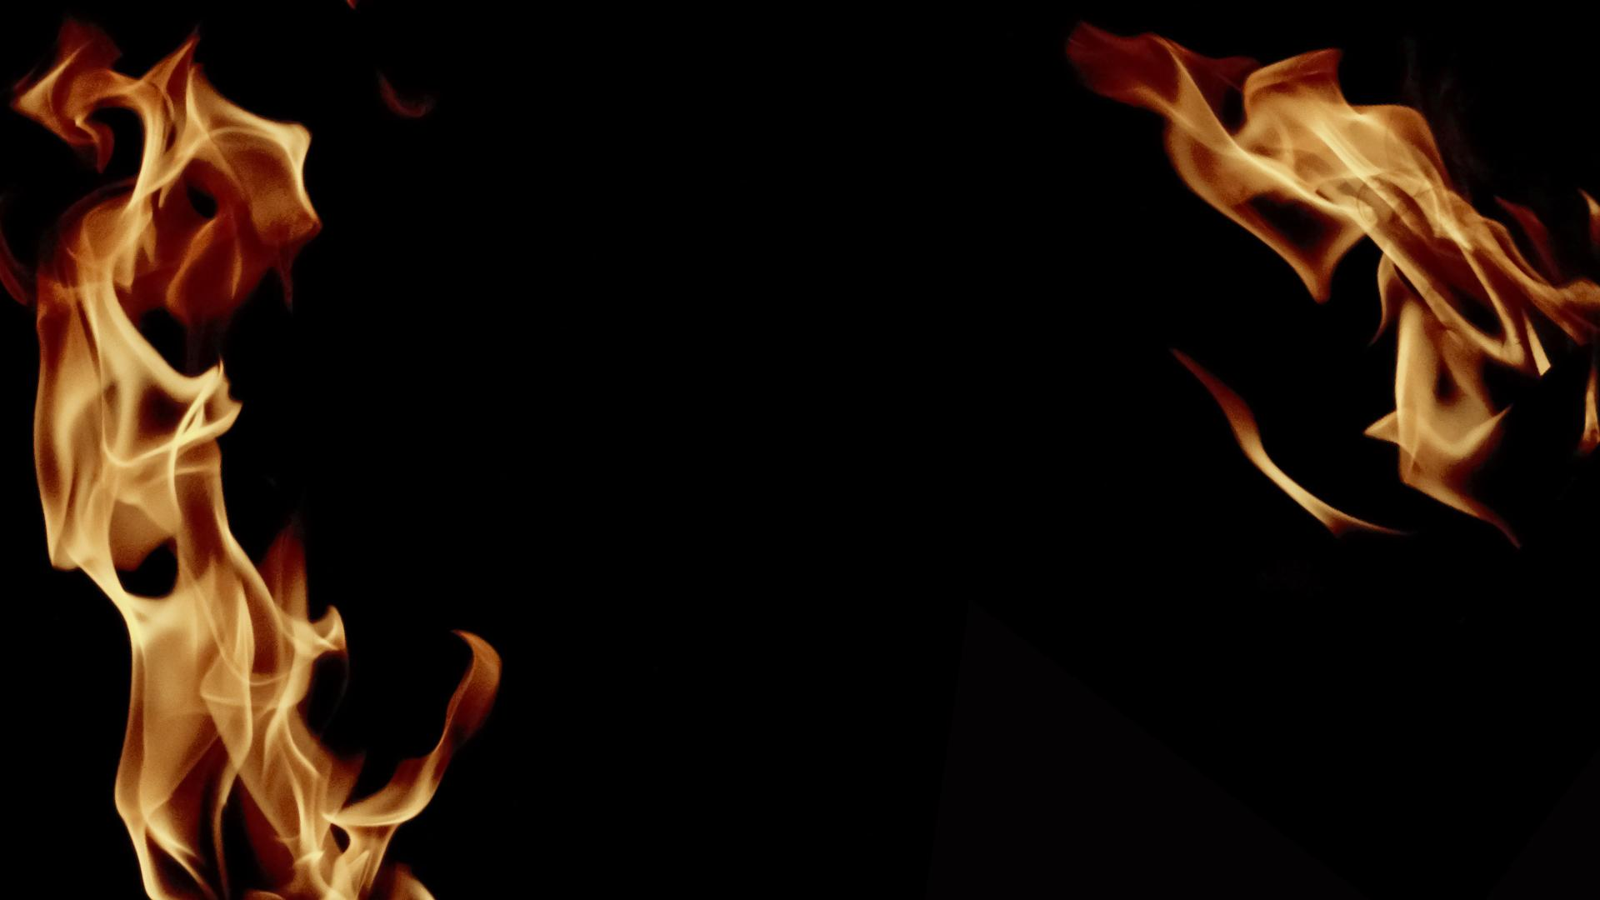
MACHINE LEARNNG

Slide 7
RANDOM FOREST
Pankaj
Insert Content here:
Point 1

Slide 8
DEEP LEARNING
Sujatha
Insert Content here:
Point 1

Slide 9
SUMMARY
Celina
Insert Content here:
Point 1

Slide 10
01
COMPANY
You could enter a subtitle here if you need it

Slide 11
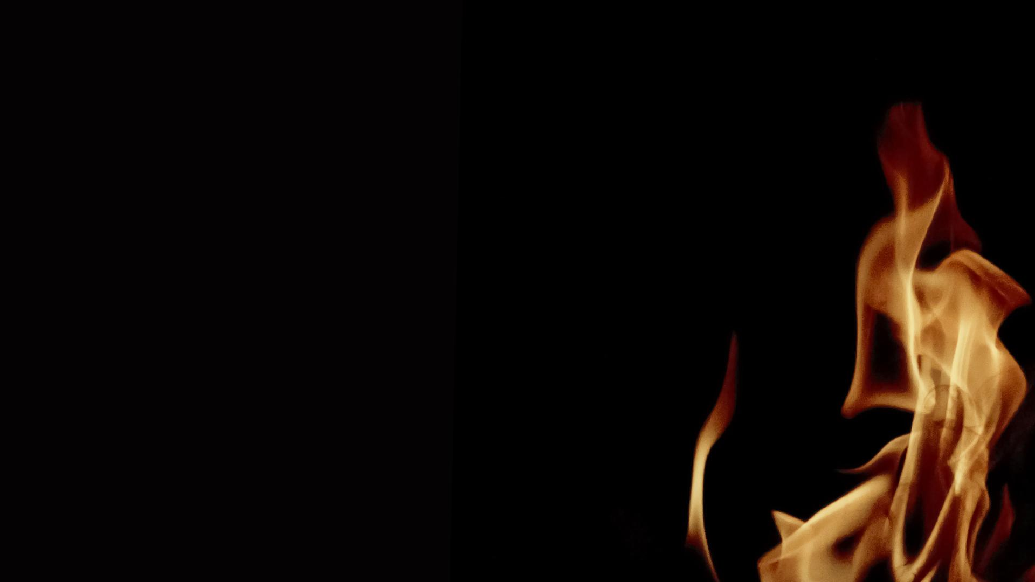
The Slide Title Goes Here!
Do you know what helps you make your point clear? Lists like this one:
They’re simple
You can organize your ideas clearly
You’ll never forget to buy milk!
And the most important thing: the audience won’t miss the point of your presentation

Slide 12
MAYBE YOU NEED TO DIVIDE THE CONTENT
MERCURY
VENUS
Mercury is the closest planet to the Sun and the smallest one
Venus has a beautiful name and is the second planet from the Sun

Slide 13
BULLET POINTS ARE VERY USEFUL
Venus has a beautiful name
This is an item from your list
This is an item from your list
This is an item from your list
This is an item from your list
This is an item from your list

Slide 14
YOU COULD USE THREE COLUMNS
MARS
JUPITER
SATURN
Despite being red, Mars is a cold place full of iron oxide dust
It’s a gas giant and the biggest planet in the Solar System
This gas giant is composed of hydrogen and also helium

Slide 15

A PICTURE IS WORTH A THOUSAND WORDS

Slide 16
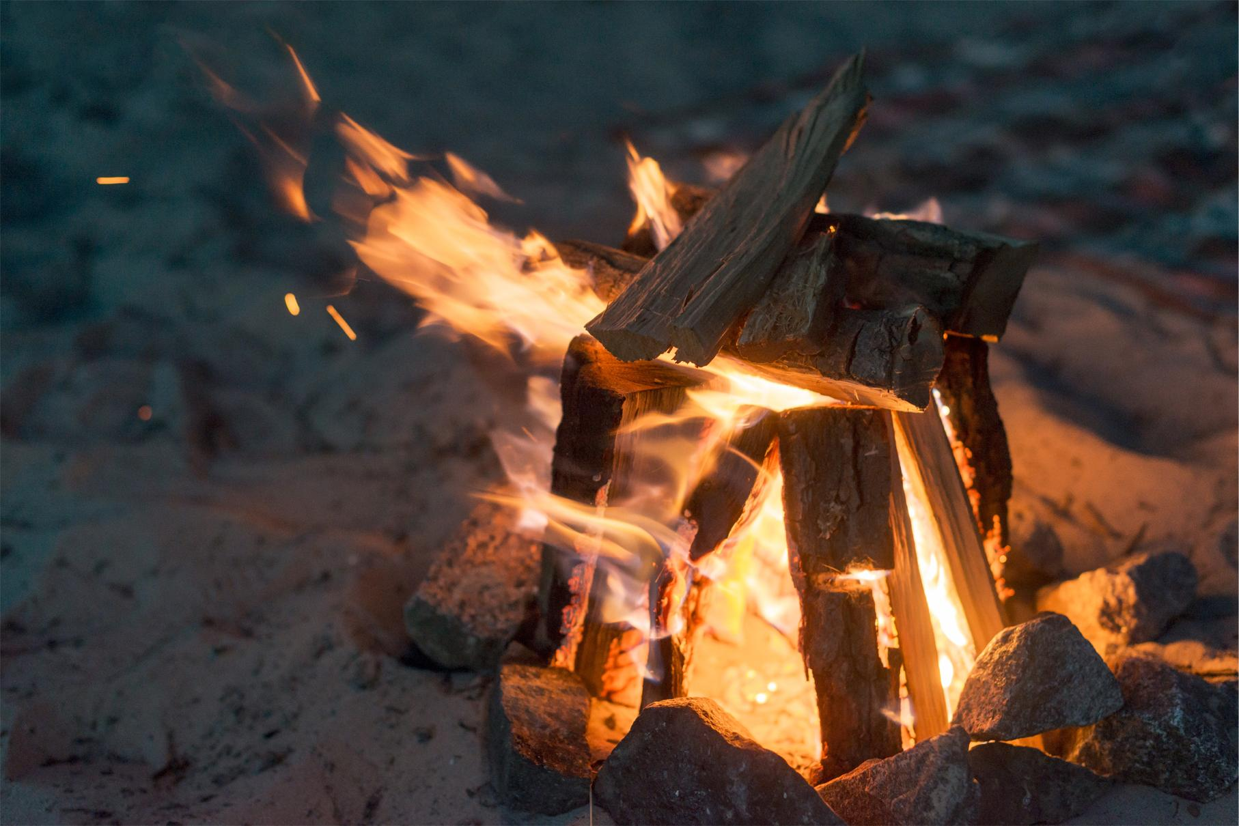
A PICTURE ALWAYS REINFORCES THE CONCEPT
Images reveal large amounts of data, so remember: use an image instead of long texts

Slide 17
YOU COULD NEED TO MAKE LISTS
Things you should do
Things you shouldn’t do
These are items from this list
These are items from this list
These are items from this list
These are items from this list
These are items from this list
These are items from this list
These are items from this list
These are items from this list
These are items from this list
These are items from this list
These are items from this list
These are items from this list

Slide 18
AWESOME WORDS
Mercury is the closest planet to the Sun and the smallest one in the Solar System

Slide 19
DO YOU NEED FOUR COLUMNS?
MERCURY
VENUS
MARS
SATURN
Mercury is the
closest planet to the Sun
Venus is the second planet from the Sun
Despite being red, Mars is a cold place
It’s composed of hydrogen and also helium

Slide 20
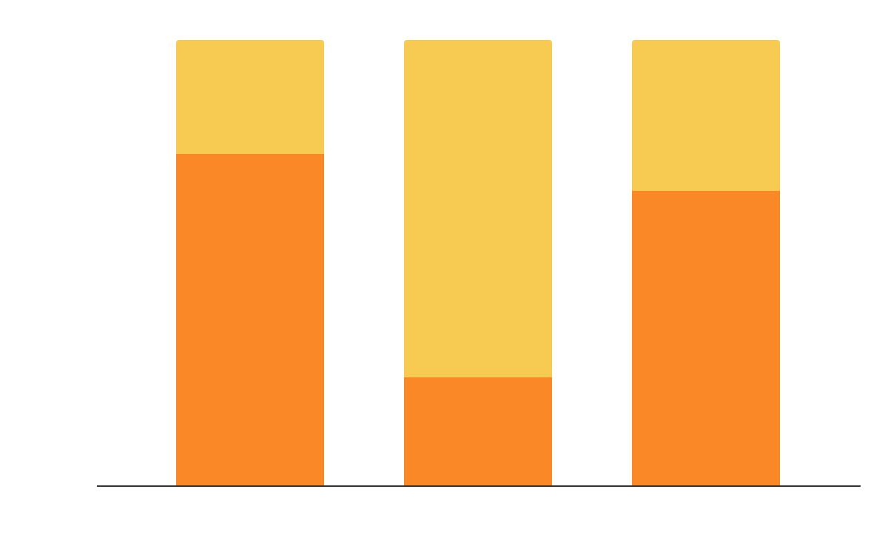
THIS IS A GRAPH
Factor 1
Factor 2
To modify this graph, click on it, follow the link, change the data and paste the new graph here

Slide 21
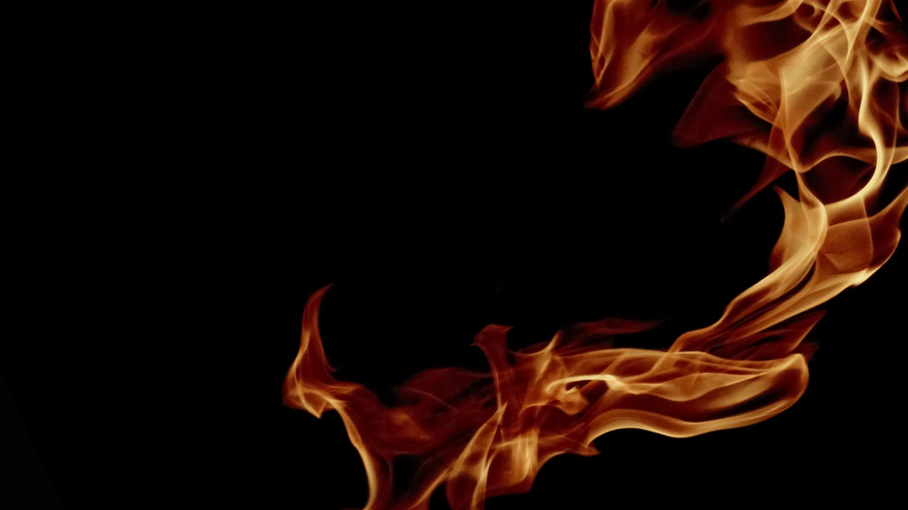
02
TARGET
You could enter a subtitle here if you need it

Slide 22
INFOGRAPHICS MAKE YOUR IDEA UNDERSTANDABLE
10%
30%
60%
Mars
venus
Mars is a cold place
Jupiter is the biggest
Venus is terribly hot

Slide 23
...AND THE SAME GOES FOR TABLES
 | MASS | DIAMETER | GRAVITY
MERCURY | 0.06 | 0.38 | 0.38
MARS | 0.11 | 0.53 | 0.38
SATURN | 95.2 | 9.4 | 1.16

Slide 24
THIS IS A MAP
10%
30%
60%
Mars is cold
Venus is hot
Mercury’s small

Slide 25
A TIMELINE ALWAYS WORKS WELL
DAY 1
DAY 3
DAY 2
DAY 4
Mercury is the closest planet
Jupiter is the biggest planet
1
2
3
4
Despite being red, Mars is cold
Saturn is the ringed one

Slide 26
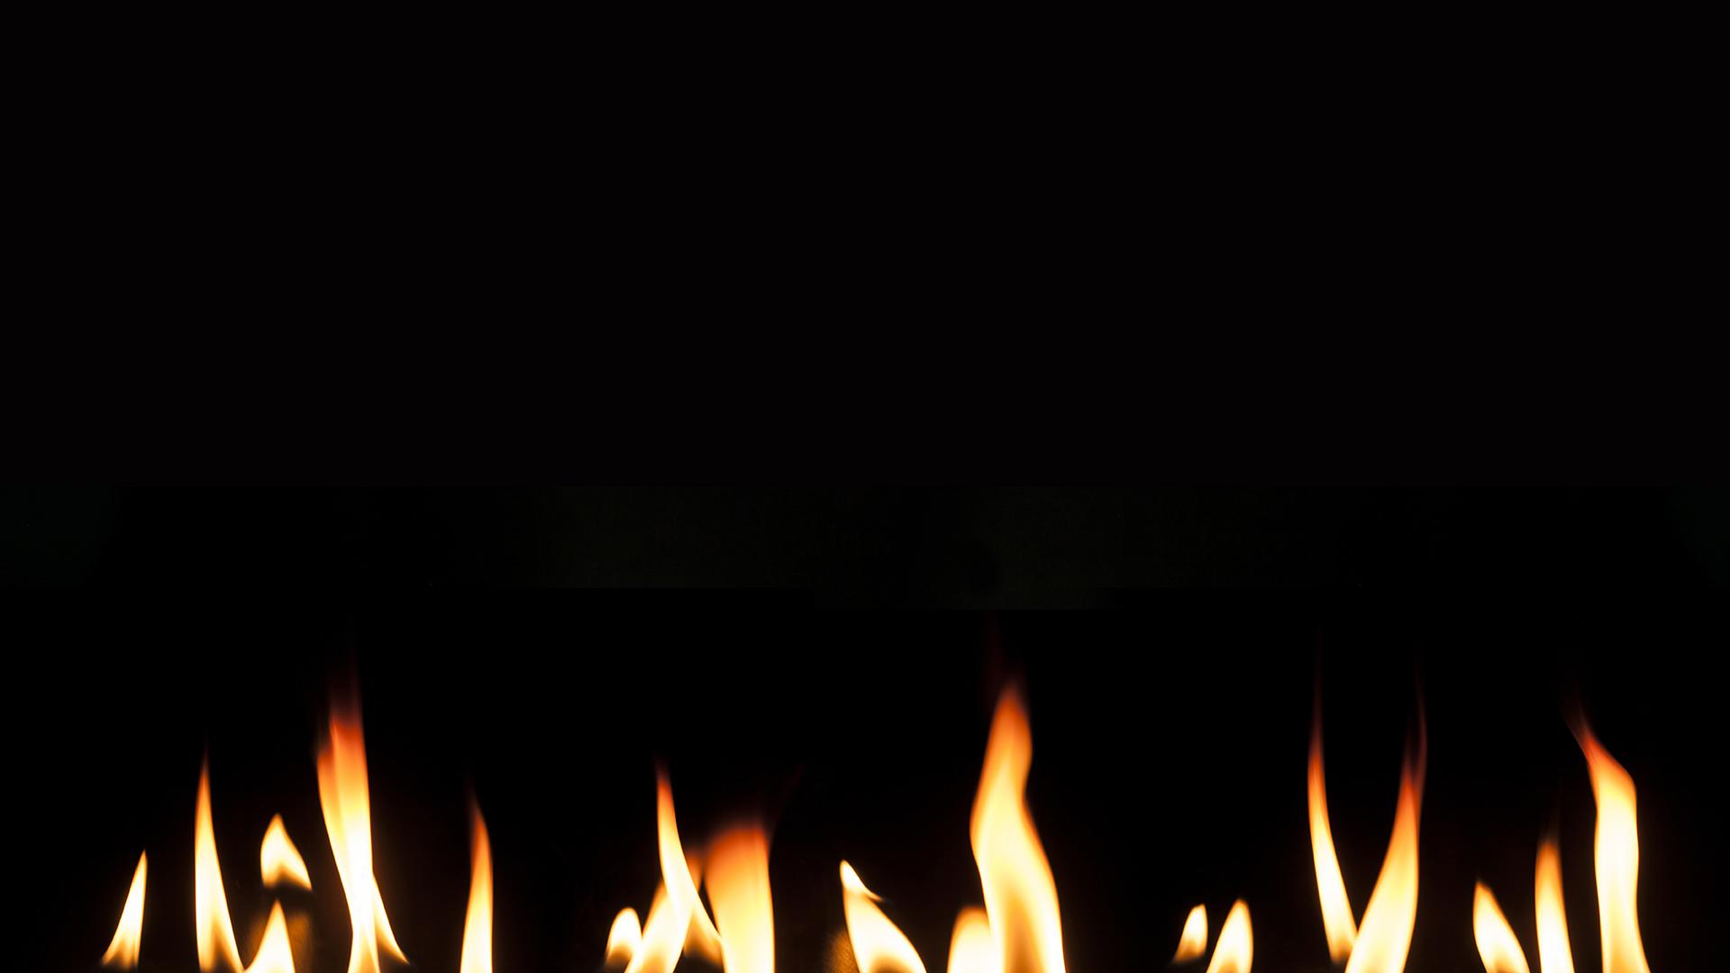
THERE ARE THE PERCENTAGES
10%
55%
35%
Mercury is the smallest planet
Venus is the second planet from the Sun
Despite being red, Mars is a cold place

Slide 27
300,000
Big numbers catch your audience’s attention

Slide 28
333,000.00
24h 37m 23s
386,000 km
Earths is the Sun’s mass
Is Jupiter’s rotation period
Is the distance between both

Slide 29
CIRCULAR PROCESS
DAY 1
DAY 3
DAY 2
DAY 4
Mercury is the smallest planet
Jupiter is the biggest planet
Despite being red, Mars is cold
Saturn is the ringed one

Slide 30
03
SERVICES
You could enter a subtitle here if you need it

Slide 31
REVIEW
MERCURY
VENUS
MARS
JUPITER
SATURN
NEPTUNE
Mercury is the smallest planet
Venus is the second planet from the Sun
Despite being red, Mars is a cold place
It’s the biggest planet in the Solar System
Saturn is the ringed one and a gas giant
It’s the farthest planet from the Sun

Slide 32
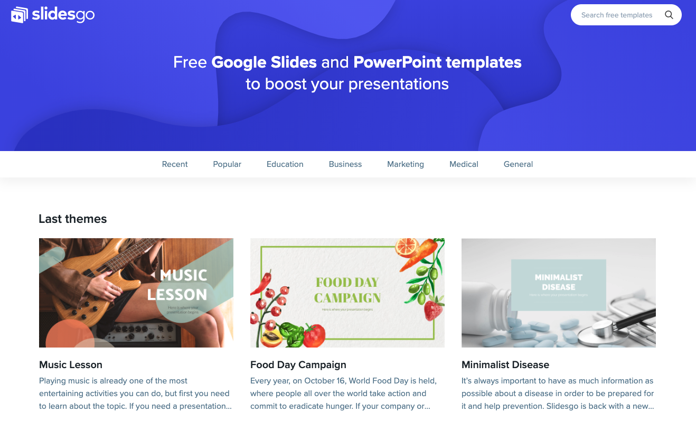
DESKTOP SOFTWARE
You can replace the image on the screen with your own work. Just delete this one, add yours and send it to the back

Slide 33
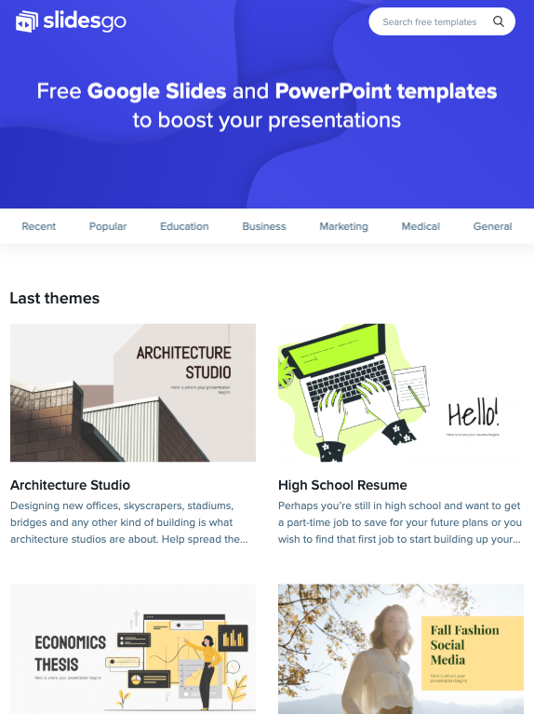

TABLET APP
You can replace the image on the screen with your own work. Just delete this one, add yours and send it to the back

Slide 34
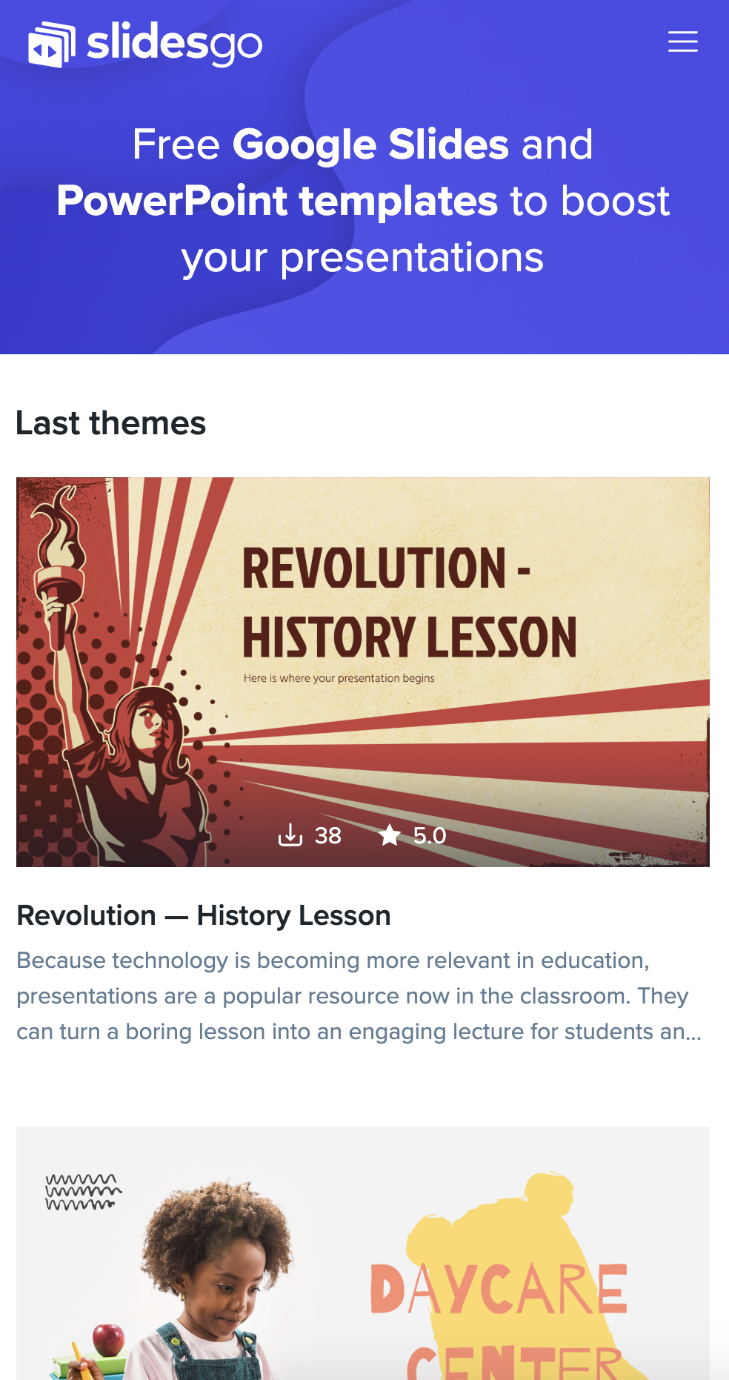
MOBILE WEB
You can replace the image on the screen with your own work. Just delete this one, add yours and send it to the back

Slide 35
THANKS!
Do you have any questions?
youremail@freepik.com
+91 620 421 838
yourcompany.com
Please keep this slide for attribution.

Slide 36
ALTERNATIVE RESOURCES
Set of holy candles burning
Couple singing by a tent with a campfire
Decorative background of fire flames
Beverage and book near fireplace
Defocused lights over candle
Burning firewood in bright bonfire
Fantastic flames on dark background
Swirling fire flame
Copy-space fireworks on new year night
Blazing flames on black background

Slide 37
RESOURCES
Did you like the resources on this template? Get them for free at our other websites.
PHOTOS:
Dark background with flames in orange tones
Camping fire burning at night
Lovely flaming candles
Moving flames on black background
Close-up flame of fire
Raging blaze of fire
Close-up swirling fire
Small blaze of fire

